Slide 1

AI-Powered Project Management Assistant
An innovative solution leveraging Prompt Engineering to revolutionize project management processes. Developed by Juilee Patil and Soumya Nayak as part of the Prompt Engineering & AI course.
by Juilee Patil : 002724809
Soumya Nayak : 002895370

Slide 2

Introduction
1
Project Overview
AI-powered project management assistant using Prompt Engineering to provide instant, accurate responses about project details.
2
Objectives
Streamline project management processes and enhance decision-making through advanced AI technologies.
3
Industry Relevance
Sets new standard for efficiency in project management, demonstrating practical application of cutting-edge AI.

Slide 3

Detailed Project Description
1
Problem Statement
Project managers struggle with quick access to specific information from voluminous documents, causing inefficiencies.
2
Solution Approach
Develop an AI bot for natural language queries, retrieving relevant information from uploaded documents.
3
Key Features
Implement NLP, vector database integration, and Streamlit interface for seamless AI interaction.
4
Expected Outcome
A robust AI-powered tool reducing information retrieval time and enhancing project management efficiency.

Slide 4
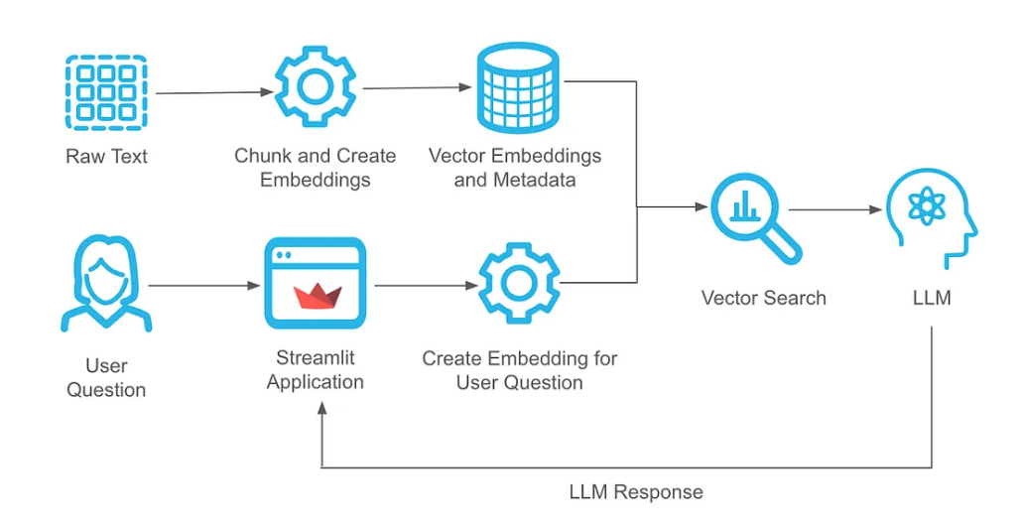
Project Architecture

Slide 5





Project Architecture Details
Document Ingestion
Upload and process project documents into structured format for AI analysis.
Embedding Creation
Convert raw text into vector embeddings with metadata.
Vector Database
Store and efficiently retrieve document embeddings using Pinecone or ChromaDB.
User Interaction
Process user queries through Streamlit, convert to embeddings, and perform vector search.
Response Generation
Utilize OpenAI's language models to generate and present contextual responses.

Slide 6





Project Overview and Objectives
Develop AI Assistant
Create an intelligent bot for understanding and responding to project queries accurately.
Enhance Information Access
Provide instant access to critical project data, improving decision-making speed.
Streamline Management
Reduce manual document searches and increase project efficiency through AI assistance.
Demonstrate RAG Pipeline
Showcase Retrieval-Augmented Generation for context-aware responses to complex queries.

Slide 7
Data Collection and Preprocessing
Document Sources
Data Extraction
Preprocessing Steps
Gather project plans, schedules, budgets, and risk documents in various formats.
Enable file uploads and organize data in structured format for processing.
Clean, normalize, and format extracted data for optimal AI processing and embedding.

Slide 8

Deployment Plan
Feedback Integration
Cloud Deployment
Implement system to collect and analyze user feedback for continuous improvement.
Utilize AWS, Streamlit cloud or Google Cloud for scalable and secure hosting.
1
2
3
4
Beta Testing
Phased Rollout
Conduct thorough testing with select project managers to gather real-world usage data.
Gradually introduce AI assistant to different project teams, monitoring performance and scaling resources.

Slide 9
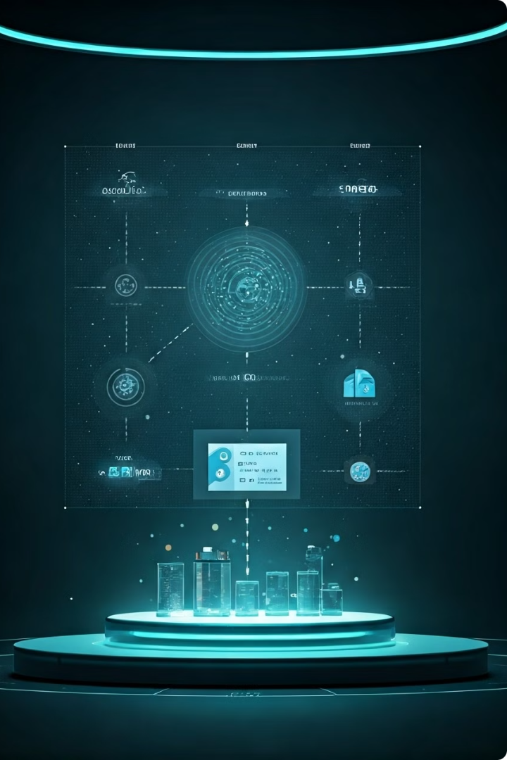
RAG Pipeline Implementation
Document Embedding
Convert preprocessed text into vector embeddings using advanced language models.
Semantic Search
Implement efficient retrieval mechanisms to find relevant document segments based on queries.
Context Augmentation
Enhance retrieved information with additional context from related document sections.
Response Generation
Utilize GPT models to generate coherent, accurate responses based on augmented information.

Slide 10
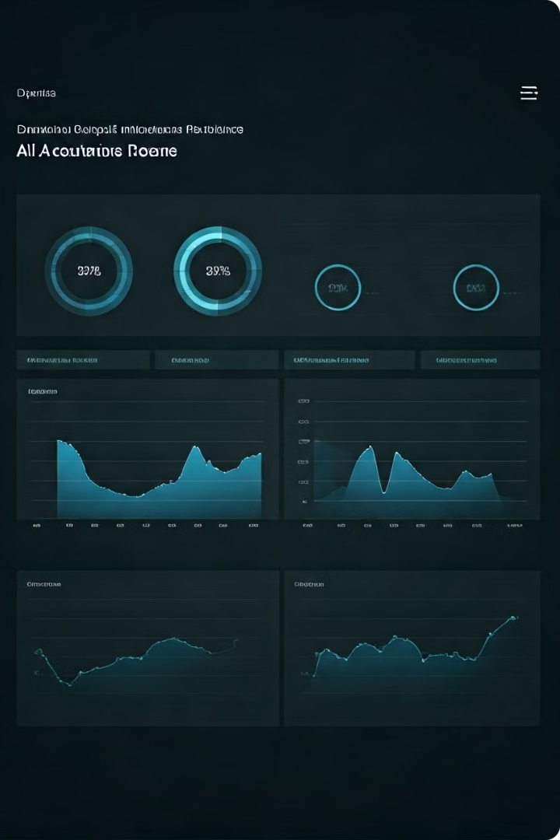
Performance Metrics
Metric
Description
Initial Results
Response Accuracy
Correctness of AI-generated answers
85%
Query Processing Time
Time taken to generate responses
3 seconds
Relevance Score
Pertinence of retrieved information
0.5 and more
Overall Rating
User satisfaction with AI assistant
4.2/5

Slide 11

Methods to Improve Metrics
1
Fine-tune Language Models
2
Optimize Vector Search
Adapt pre-trained models to project management domain for improved accuracy and relevance.
Implement advanced indexing and clustering techniques to enhance retrieval speed and accuracy.
3
Expand Training Data
4
Implement User Feedback Loop
Incorporate wider range of project documents to improve AI's knowledge base.
Continuously learn and improve from user interactions and explicit feedback.

Slide 12

Future Work and Vision
Multi-lingual Support
Integration with PM Tools
Expand AI capabilities to understand and respond in multiple languages for global teams.
Develop plugins for popular project management software to incorporate AI assistant into existing workflows.
Predictive Analytics
Voice Interface
Implement advanced machine learning models to provide insights on project risks and outcomes.
Add voice recognition and synthesis capabilities for hands-free interaction with AI assistant.

Slide 13
Conclusion
Summary
Key Takeaways
Final Thoughts
Successfully developed AI-powered project management assistant leveraging RAG technology for accurate, timely information retrieval.
Highlighted importance of tool selection, model fine-tuning, and continuous improvement based on user feedback.
Project serves as foundation for future research in AI-powered project management, with potential for expanded capabilities.

Slide 14
Q & A

Slide 15
Thank You !

